Slide 1
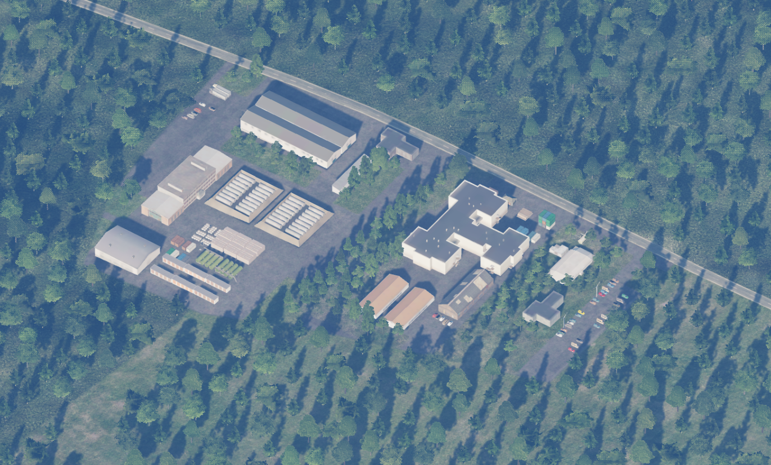
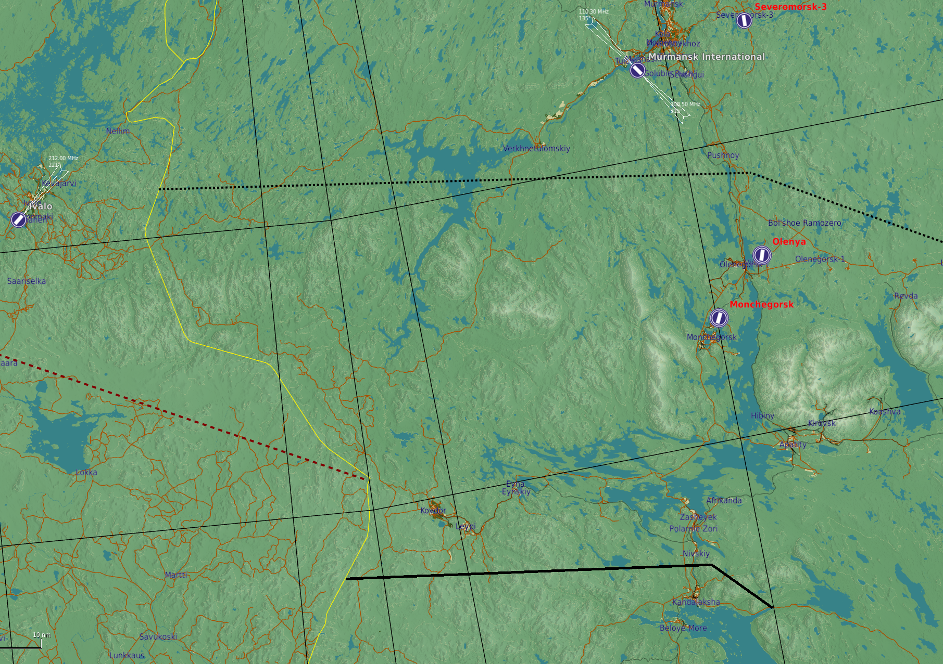


SRNTGT089 SCUD Facility
SRNTGT089B
SRNTGT089A 1,2
N
---
1
2
SRNTGT089C
SRNTGT089D
DESCRIPTION OF THE DESIRED POINTS OF IMPACT WITH WPN TYPE:
N 68 04.798 E 034 07.352, - 865 ft - SRNTGT089 A-1: Rocket propellant storage
N 68 04.785 E 034 07.389, - 865 ft - SRNTGT089 A-2: Rocket propellant storage
N 68 04.730 E 034 07.576, - 865 ft - SRNTGT089 B: Headquarter
N 68 04.778 E 034 07.248, - 865 ft - SRNTGT089 C: Repair facility
N 68 04.805 E 034 07.309, - 865 ft - SRNTGT089 D: Storage Facility

Slide 2
SRNTGT089 SCUD Facility
SRNTGT089 A-1: Rocket propellant storage
At least 1x 1,000 lbs advised
SRNTGT089 A-2: Rocket propellant storage
At least 1x 1,000 lbs advised
SRNTGT089 B: Headquarter
Light office building for command staff, 1x500 lbs weapon sufficient
SRNTGT089 C: Repair facility
The actual target is the facility’s crane structure – 1x1,000lbs weapon is sufficient
SRNTGT089 D: Storage Facility
Hard concrete structure with basement as target – 1x2,000lbs class weapon advised, possible effectiveness with 2x1,000 lbs.
SRNTGT089D
SRNTGT089A 1,2
N
1
2
SRNTGT089C
SRNTGT089B
DESCRIPTION OF THE DESIRED POINTS OF IMPACT WITH WPN TYPE:
N 68 04.798 E 034 07.352, - 865 ft - SRNTGT089 A-1: Rocket propellant storage
N 68 04.785 E 034 07.389, - 865 ft - SRNTGT089 A-2: Rocket propellant storage
N 68 04.730 E 034 07.576, - 865 ft - SRNTGT089 B: Headquarter
N 68 04.778 E 034 07.248, - 865 ft - SRNTGT089 C: Repair facility
N 68 04.805 E 034 07.309, - 865 ft - SRNTGT089 D: Storage Facility

Slide 3
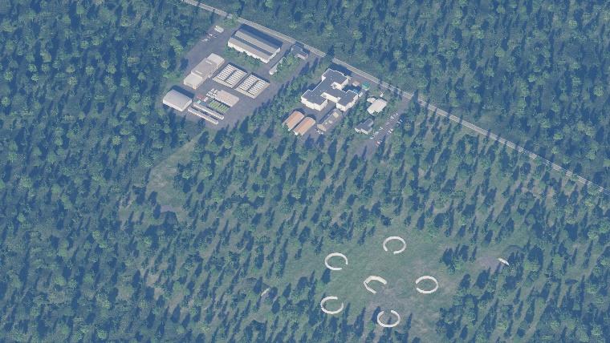
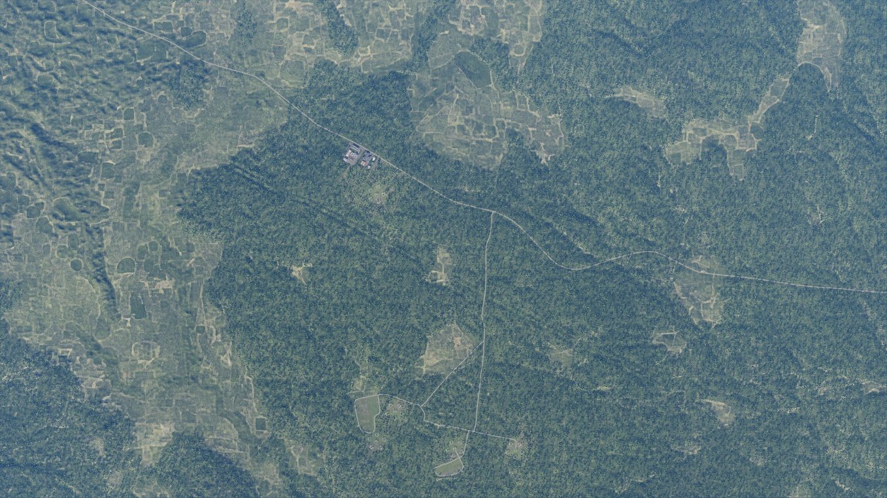
SRNTGT089 SCUD Facility
N
N
SRNTGT089
1 NM
SECONDARY IMPLICATION
In event of TGP attack, secondary is to recon the nearby launch pads to the south-east and further south

